Slide 1
Covidien Gateway Prototype With RS232
January 3, 2012
By Shahid N. Shah

Slide 2
In US hospital practice today
Hospitals currently using RS-232 to IP devices for collecting data from bedside devices including:
Ventilators
Pulse oximeters
Patient monitors
Infusion pumps
Anesthesia machines
Cardiac monitors

Slide 3
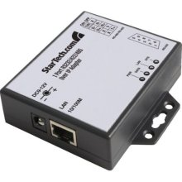
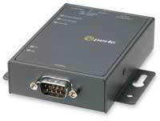
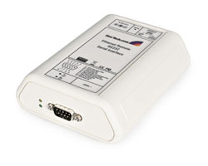
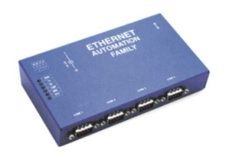

Multiple Device RS-232 to IP options
Examples of single port adaptors:
Potential Configurations
Browser based configuration
Plug & Play installation utility
IPv4 some with IPv6 support
Failover host support
Internet tunneling control possible
IEC 60601-1 medical safety standard compliant devices available
Serial over SSL
And multiport adaptors:

Slide 4
Publish/Subscribe – low coupling compatible solution
Gateway
Med Device
Med Device
Data Store
EHR / HIS
Remote UI
Alarm Handler
Supports one-to-one, one-to-many, many-to-one, and many-to-many communications
Cloud / EHR / HIS
iOS
Android
Server or
Phone
PC App
Mobile App
Any others
EXTERNAL DEVICE
(Concentrator)
The RS-232 to IP Concentrator gets legacy devices into the mix without a re-design

Slide 5
Requirements in Serial Port
IDL type definition
Type of data format is received
Physical connection between the devices
Serial port control including:
Packet size control
Idle time control
Force transmit time
Frame Definition

Slide 6

Potential Data Flow
CovidienDevice
RS-232 data feed
Concentrator
Data packaged for TCP/UDP transport
(could include SSL)
Cloud data transport
Device adaptor
Data parsed – existing(?)
Covidien library
Publisher
(IDL) Data pushed to a Topic
Subscriber
Subscribers notified

Slide 7
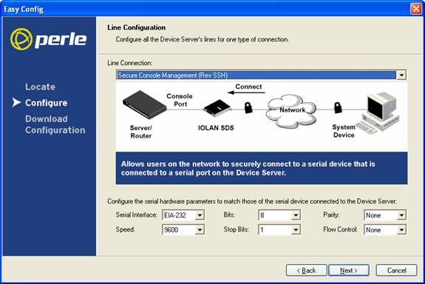
Installation and Administration
Two different vender installation and configuration management tools.
Each allows for serial data control, virtual COMM ports, and Device identification

Slide 8
Architecture Covidien Gateway with RS232
MEDICAL
DEVICE
Serial port to Serial port
MEDICAL
DEVICE
Serial port To USB
DDS
DDS
MEDICAL
DEVICE
EXTERNAL DEVICE
(Concentrator)
SUBSCRIBER
PUBLISHER
Serial port to ethernet [TCP/UDP]
PUBLISHER
SUBSCRIBER
PUBLISHER
SUBSCRIBER
Data Generator
PUBLISHER
SUBSCRIBER

Slide 9
Legacy device to Gateway (direct)
Serial Port to Serial Port Communication:
Requirements are RS-232 cable and the library file
The library files should be included in the source code to manage communications between two serial ports.
Some of the libraries available for serial to serial communication
Termios - C library
Libserial - C++ library
Boost.ASIO-++ Boost Library
MEDICAL
DEVICE
PUBLISHER
RS232 CABLE

Slide 10
Legacy device to Gateway (direct)
Serial Port to Ethernet:
Serial to Ethernet need a external device to convert the serial data to TCP/UDP packets. There are many devices available.
Examples include:
http://www.perle.com/products/Serial-to-thernet.shtm
http://aaxeon.com/Products/Serial%20to%20Ethernet.html
Data will be retrieved through a usual socket program between the External device and publisher. In the external device we receive the serial data and converted into TCP/UDP packets.
Note : Wireless external device also has same process
EXTERNAL DEVICE
(Concentrator)
MEDICAL
DEVICE
PUBLISHER
RS232 CABLE
ETHERNET

Slide 11
Legacy device to Gateway (direct)
Serial Port to USB :
Serial to USB need a serial to USB adapter to convert the serial data to USB. There are many adapters available for this. Some of the adaptors given below
http://www.digi.com/products/usb/anywhereusb
http://www.fugawi.com/web/products/hardware_usb_cable.html
In this case we need to use own code to retrieve the USB data. Based on the USB protocol we have to write code. Otherwise we need to use some of the third party libraries.
MEDICAL
DEVICE
PUBLISHER
SER IAL TO USB ADAPTER

Slide 12
Legacy device data format to DDS
Command Line options for# ./<device>-serial-pub
Available options for are:
--help Produce help message
--device-path Device path ex: /dev/tty1So1
(Used for Serial-to-Serial and Serial-to-USB)
--data-gen-ip arg Data Generator IP (Converter IP)
--data-gen-port arg Data Generator Port (Configured port)
--domain arg Device Domain
--device-id arg Device ID - for device identification
--log-info arg Log Info Specification
--log-data arg Log Data Specification
--log4cpp-conf arg Log Configuration and Format specification file

Slide 13
Legacy device data format to DDS
There is no difference in the subscriber side for Serial port based publishers
./serial-sub {command line options}
Available options for
--help Produce help message
--domain Device Domain
--device-id Device ID - for device identification
--log-info arg Log Info Specification
--log-data arg Log data Specification
--log4cpp-conf arg Log Configration and Format specification file

